Slide 1
Chapter 13:
Overloading and Templates

Slide 2
Objectives
In this chapter, you will
  Learn about overloading
  Become aware of the restrictions on operator overloading
  Examine the pointer this
  Learn about friend functions
C++ Programming: From Problem Analysis to Program Design, Sixth Edition

Slide 3
Objectives (cont’d.)
In this chapter, you will (cont’d.)
  Explore the members and nonmembers of a class
  Overload various operators
  Learn about templates
  Construct function templates and class templates
C++ Programming: From Problem Analysis to Program Design, Sixth Edition

Slide 4
Introduction
Templates: enable you to write generic code for related functions and classes
Function templates: used to simplify function overloading
C++ Programming: From Problem Analysis to Program Design, Sixth Edition

Slide 5

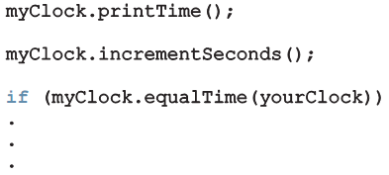
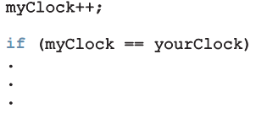
Why Operator Overloading Is Needed
Consider the following statements:
Which of the following would you prefer?
cout << myClock;
C++ Programming: From Problem Analysis to Program Design, Sixth Edition
Notes:
The operator >> is used as both a stream extraction operator and a right shift operator. The operator << is used as both a stream insertion operator and a left shift operator.
The first statement declares myClock to be an object of type clockType and initializes the member variables hr , min , and sec of myClock to 8 , 23 , and 34 , respectively.
The second statement declares yourClock to be an object of type clockType and initializes the member variables hr , min , and sec of yourClock to 4 , 5 , and 30 , respectively.
Now consider the following statements:
myClock.printTime();
myClock.incrementSeconds();
if (myClock.equalTime(yourClock))
….
The first statement prints the value of myClock in the form hr:min:sec . The second statement increments the value of myClock by one second. The third statement checks whether the value of myClock is the same as the value of yourClock .
However, if we can use the insertion operator << to output the value of myClock , the increment operator ++ to increment the value of myClock by one second, and relational operators for comparison, we can enhance the flexibility of the class clockType considerably. we prefer to use the
following statements instead of the previous statement
cout << myClock;

Slide 6
Why Operator Overloading Is Needed (cont’d.)
Assignment and member selection are the only built-in operations on classes
  Other operators cannot be applied directly to class objects
Operator overloading: extends definition of an operator to work with a user-defined data type
  C++ allows you to extend the definitions of most of the operators to work with classes
C++ Programming: From Problem Analysis to Program Design, Sixth Edition

Slide 7
Operator Overloading
Most existing C++ operators can be overloaded to manipulate class objects
Cannot create new operators
Operator function: overloads an operator
  Use reserved word operator as the function name
C++ Programming: From Problem Analysis to Program Design, Sixth Edition
Notes:
Operator overloading is the process by which you apply operators to your own abstract data types. 6 + 3, it is clear what should be added. Classes, however, contain a variety of data members. As a result, if you want the compiler to perform arithmetic with two objects, you must tell the compiler what you mean. When you add two Students using the + operator, you might intend to add their tuition bills, their credit hours, or their library fines.

Slide 8
Syntax for Operator Functions
Syntax of an operator function heading:
  It is a value-returning function
  operator is a reserved word
To overload an operator for a class:
  Include operator function declaration in the class definition
  Write the definition of the operator function
C++ Programming: From Problem Analysis to Program Design, Sixth Edition
Notes:
In order to overload operators, you must write functions (that is, the header and body). The name of the function that overloads an operator is the reserved word operator followed by the operator to be overloaded. For example, the name of the function to
overload the operator >=

Slide 9
Overloading an Operator: Some Restrictions
Cannot change precedence or associativity
Default parameters cannot be used
Cannot change number of parameters
Cannot create new operators
Cannot overload: . .* :: ?: sizeof
How the operator works with built-in types remains the same
  Can overload for user-defined objects or for a combination of user-defined and built-in objects
C++ Programming: From Problem Analysis to Program Design, Sixth Edition
Notes:
When overloading an operator, keep the following in mind:

Slide 10
Pointer this
Every object of a class maintains a (hidden) pointer to itself called this
When an object invokes a member function
  this is referenced by the member function: All member functions receive a this pointer that contains a reference to the object using the function.
C++ Programming: From Problem Analysis to Program Design, Sixth Edition
Notes:
A member function of a class can (directly) access the member variables of that class for a given object. Sometimes, it is necessary for a member function to refer to the object as a whole, rather than the object’s individual member variables. How do you refer to the object as a whole (that is, as a single unit) in the definition of the member function, especially when the object is not passed as a parameter? Every object of a class maintains a (hidden) pointer to itself, and the name of this pointer is this .
When an object invokes a member function, the member function
references the pointer this of the object. For example, suppose that test is a class
and has a member function called one . Further suppose that the definition of one
looks like the following:
test test::one() {….
return *this; }
If x and y are objects of type test , then the statement:
y = x.one();
copies the value of object x into object y . That is, the member variables of x are copied into the corresponding member variables of y . When object x invokes function one , the pointer this in the definition of member function one refers to object x , so this means the address of x and *this means the value of x .

Slide 11
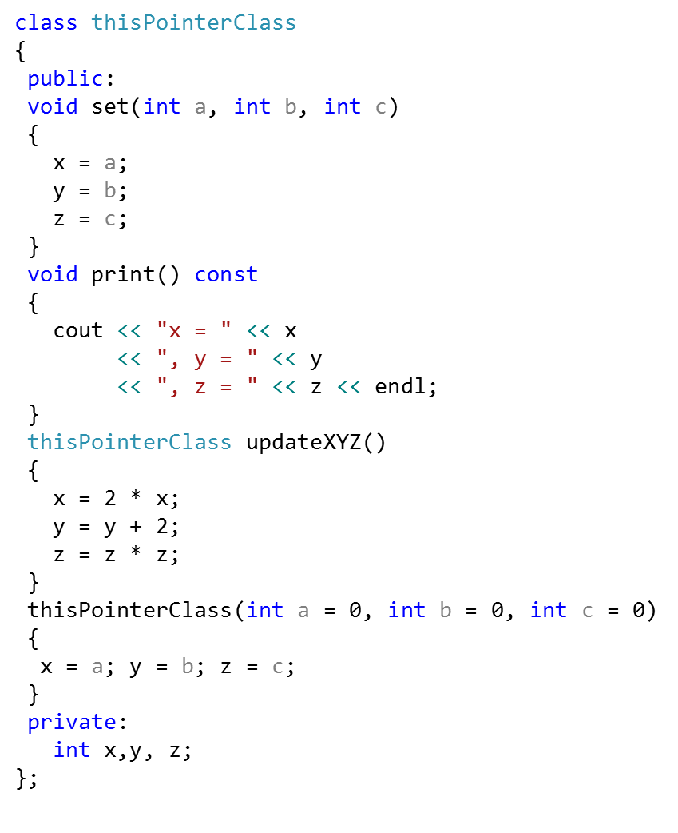
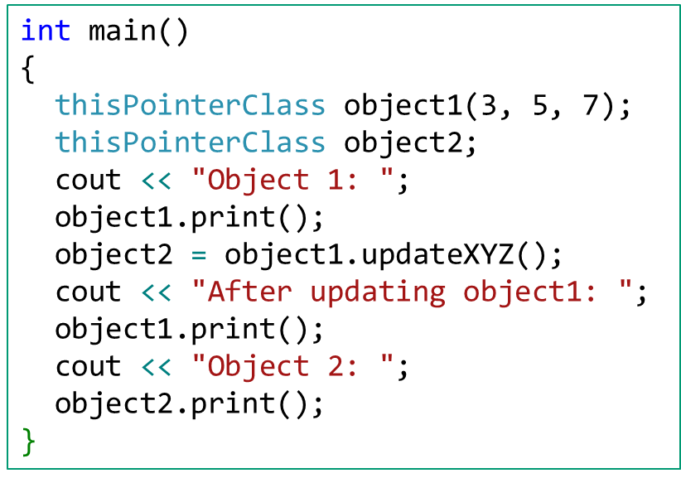
Pointer this
Object 1: x = 3, y = 5, z = 7
After updating object1: x = 6, y = 7, z = 49
Object 2: x = 6, y = 7, z = 49
C++ Programming: From Problem Analysis to Program Design, Sixth Edition
Notes:
A member function of a class can (directly) access the member variables of that class for a given object. Sometimes, it is necessary for a member function to refer to the object as a whole, rather than the object’s individual member variables. How do you refer to the object as a whole (that is, as a single unit) in the definition of the member function, especially when the object is not passed as a parameter? Every object of a class maintains a (hidden) pointer to itself, and the name of this pointer is this .
When an object invokes a member function, the member function
references the pointer this of the object. For example, suppose that test is a class
and has a member function called one . Further suppose that the definition of one
looks like the following:
test test::one() {….
return *this; }
If x and y are objects of type test , then the statement:
y = x.one();
copies the value of object x into object y . That is, the member variables of x are copied into the corresponding member variables of y . When object x invokes function one , the pointer this in the definition of member function one refers to object x , so this means the address of x and *this means the value of x .

Slide 12
Pointer this
void personType::setName(string first, string last) {
firstName = first;
lastName = last;
}
personType& personType::setLastName(string last) {
lastName = last;
return *this;
}
personType& personType::setFirstName(string first) {
firstName = first;
return *this;
}
C++ Programming: From Problem Analysis to Program Design, Sixth Edition
Notes:
A member function of a class can (directly) access the member variables of that class for a given object. Sometimes, it is necessary for a member function to refer to the object as a whole, rather than the object’s individual member variables. How do you refer to the object as a whole (that is, as a single unit) in the definition of the member function, especially when the object is not passed as a parameter? Every object of a class maintains a (hidden) pointer to itself, and the name of this pointer is this .
When an object invokes a member function, the member function
references the pointer this of the object. For example, suppose that test is a class
and has a member function called one . Further suppose that the definition of one
looks like the following:
test test::one() {….
return *this; }
If x and y are objects of type test , then the statement:
y = x.one();
copies the value of object x into object y . That is, the member variables of x are copied into the corresponding member variables of y . When object x invokes function one , the pointer this in the definition of member function one refers to object x , so this means the address of x and *this means the value of x .

Slide 13
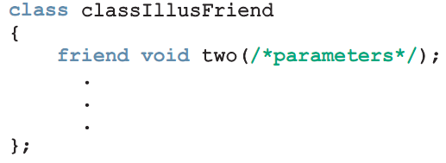
Friend Functions of Classes
Friend function (of a class): a nonmember function of the class that has access to all the members of the class
Use the reserved word friend in the function prototype in the class definition
C++ Programming: From Problem Analysis to Program Design, Sixth Edition
Notes:
Creating classes that contain private data and public interfaces to the data is a hallmark of object-oriented programming, in part because the technique allows objects to resemble their real-world counterparts. However, you occasionally may want to allow some outside functions to have access to private data so that you can add “natural” language features to your objects, such as arithmetic operators and insertion and extraction operators.
Encapsulation and data hiding are two primary features of object-oriented programs. You use encapsulation when you place data and functions together in a capsule as objects. You use data hiding when you create private class members; they remain inaccessible to functions that are not part of the class.
Sometimes, however, it is convenient to allow an outside, nonmember function to have access to a privatedata member. For example, you might have two objects that belong to different classes, and you want a single function to use data members from each object. If the function is a member of the first class, it doesn’t have access to the data in the second class; if the function is a member of the second class, it doesn’t have access to the data in the first. One solution to this dilemma is to create special functions called friendfunctions.

Slide 14
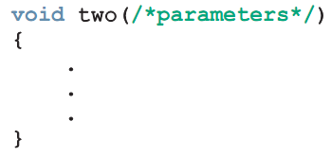
Definition of a friend Function
"friend" doesn’t appear in function definition
When writing the friend function definition
  The name of the class and the scope resolution operator are not used
C++ Programming: From Problem Analysis to Program Design, Sixth Edition
Notes:
A friendclass is a class in which every function can access non-public members of another class; in other words, every function in a friend class is a friend function.

Slide 15
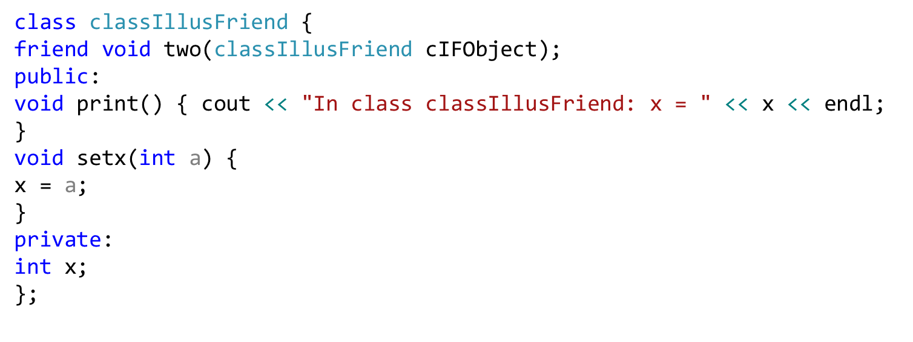
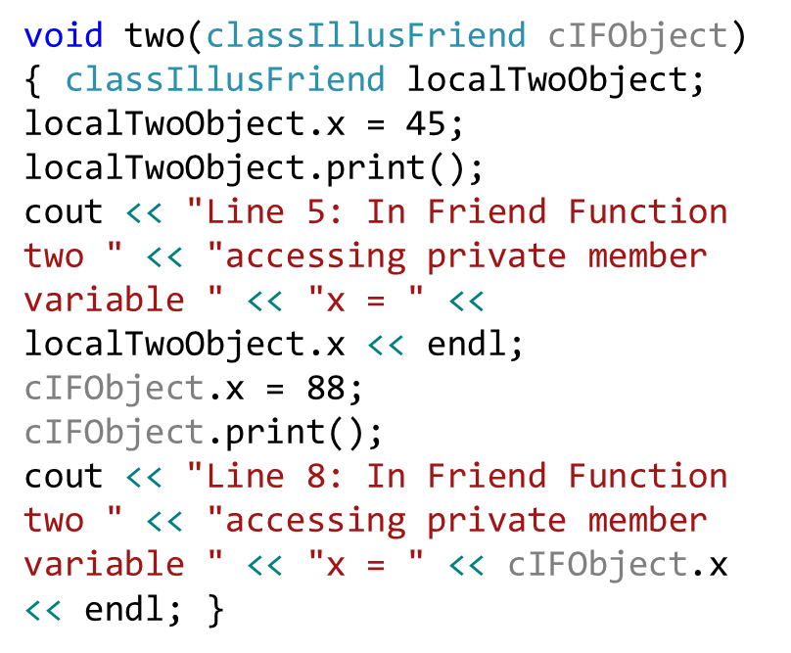
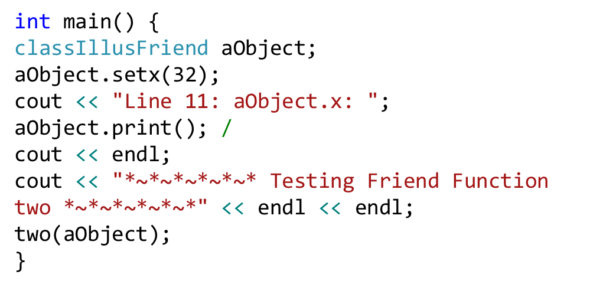
Definition of a friend Function
C++ Programming: From Problem Analysis to Program Design, Sixth Edition
Notes:
A friendclass is a class in which every function can access non-public members of another class; in other words, every function in a friend class is a friend function.

Slide 16
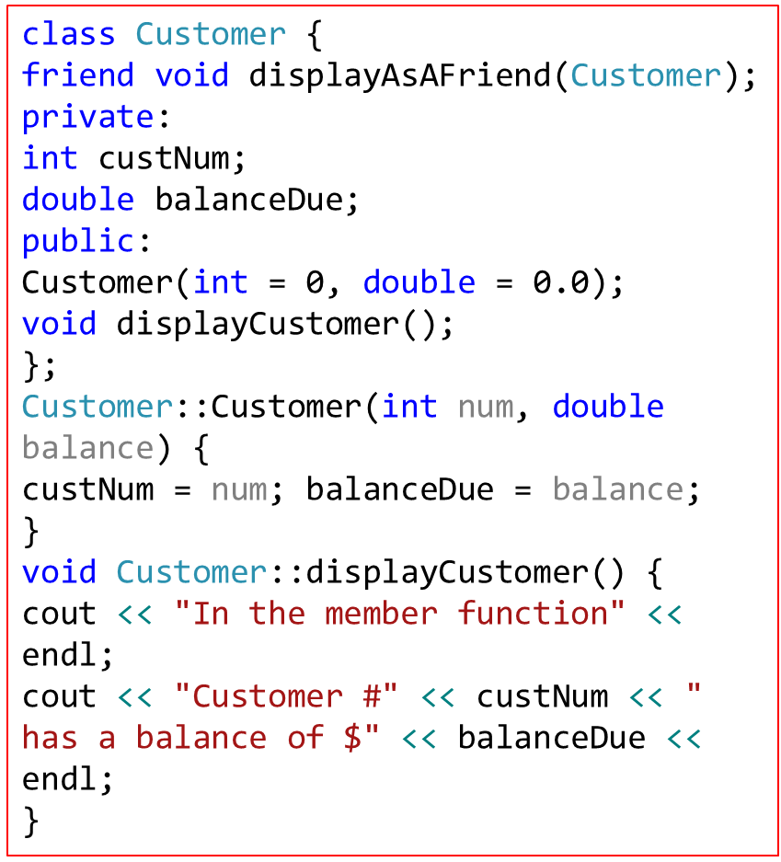
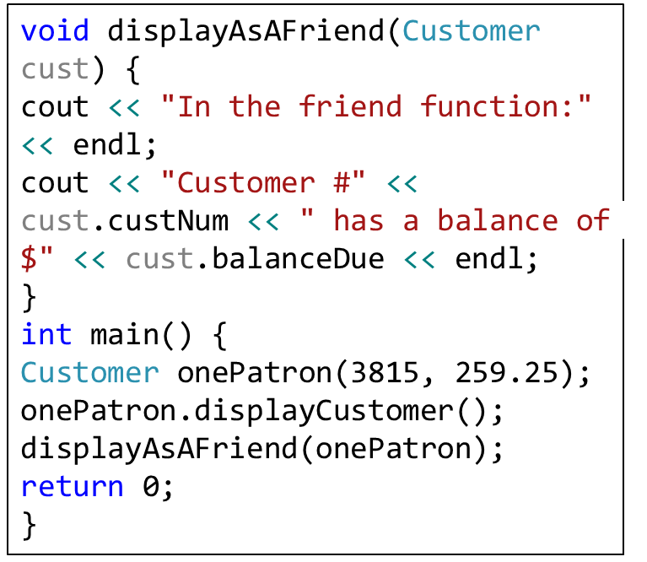
Definition of a friend Function
In the member function
Customer #3815 has a balance of $259.25
In the friend function:
Customer #3815 has a balance of $259.25
C++ Programming: From Problem Analysis to Program Design, Sixth Edition
Notes:
A friendclass is a class in which every function can access non-public members of another class; in other words, every function in a friend class is a friend function.

Slide 17
USING A FRIEND FUNCTION TO ACCESS DATA FROM TWO CLASSES
Let we have a Transaction class. You might create a Transactionobject for each customer transaction, such as a purchase of an item, payment on an account, or return of an item. The Transaction has an identification number and contains a field that identifies the customer who made the payment, purchase, or return. A field also holds the amount of the transaction. Periodically, you might want to update a customer’s record (a Customer object) with transaction information. For example, a customer might start the month with a $200 balance and make a payment of $150. After updating, the customer’s record should show a $50 balance.
C++ Programming: From Problem Analysis to Program Design, Sixth Edition

Slide 18
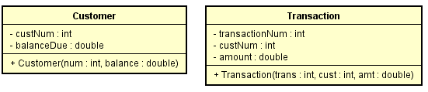
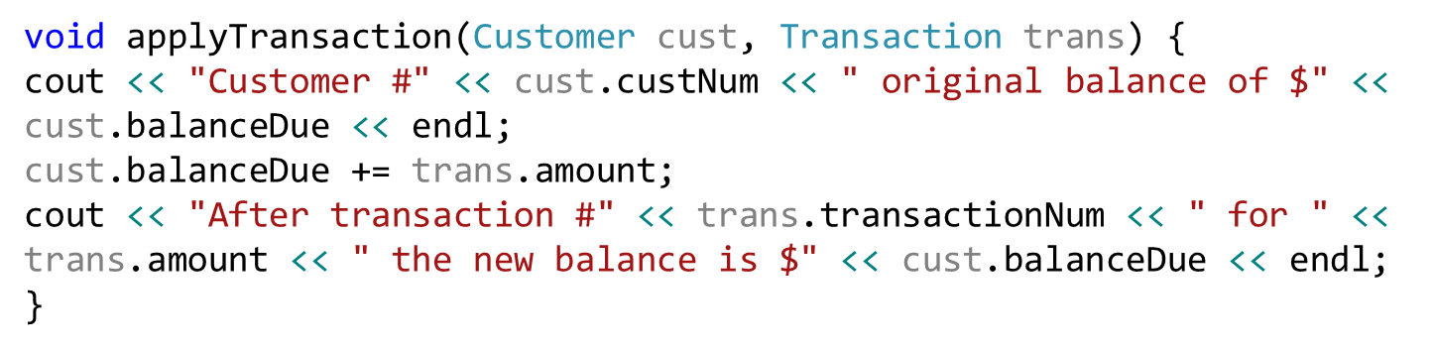
USING A FRIEND FUNCTION TO ACCESS DATA FROM TWO CLASSES
C++ Programming: From Problem Analysis to Program Design, Sixth Edition

Slide 19
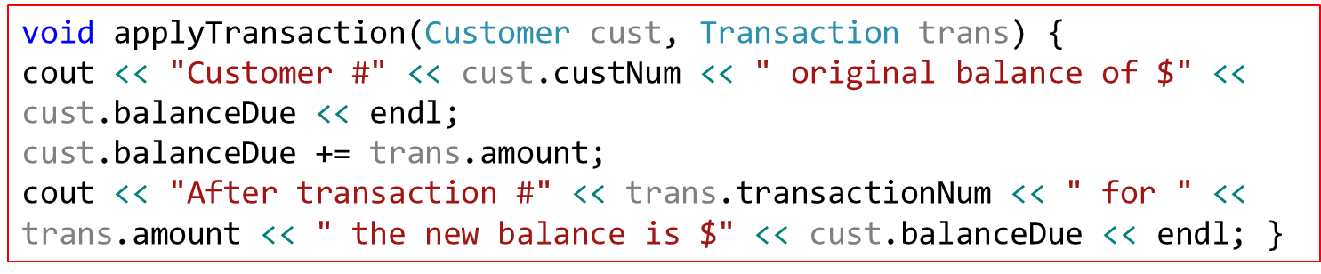
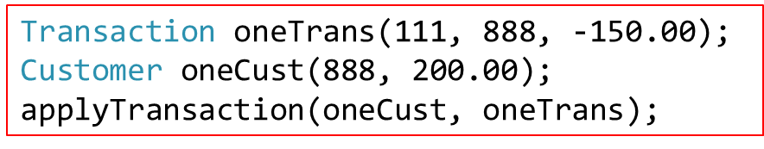
USING A FRIEND FUNCTION TO ACCESS DATA FROM TWO CLASSES
Customer #888 original balance of $200
After transaction #111 for -150 the new balance is $50
C++ Programming: From Problem Analysis to Program Design, Sixth Edition

Slide 20
Operator Functions as Member and Nonmember Functions
To overload (), [], ->, or = for a class, the function must be a member of the class
If op is overloaded for opOverClass:
  If the leftmost operand of op is an object of a different type, the overloading function must be a nonmember (friend) of the class
  If the overloading function for op is a member of opOverClass, then when applying op on objects of type opOverClass, the leftmost operand must be of type opOverClass
C++ Programming: From Problem Analysis to Program Design, Sixth Edition
Notes:
The beginning of this chapter stated that certain rules must be followed when you include
an operator function in the definition of a class. This section describes these rules.
Most operator functions can be either member functions or nonmember functions—that
is, friend functions of a class. To make an operator function be a member or nonmember
function of a class, keep the following in mind:

Slide 21
Overloading Binary Operators
If # represents a binary operator (e.g., + or ==) that is to be overloaded for rectangleType
  It can be overloaded as either a member function of the class or as a friend function
C++ Programming: From Problem Analysis to Program Design, Sixth Edition

Slide 22
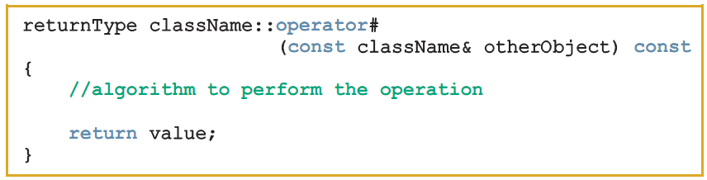
Overloading the Binary Operators as Member Functions
obj1 # obj2
obj1.operator#(obj2)
Function prototype (included in the class definition):
Function definition:
C++ Programming: From Problem Analysis to Program Design, Sixth Edition
Notes:
myRectangle and yourRectangle are objects of type rectangleType, you
can perform the operation:
myRectangle # yourRectangle
The compiler translates this expression into the following expression:
myRectangle.operator#(yourRectangle)
This expression clearly shows that the function operator# has only one parameter,
which is yourRectangle.
Because operator# is a member of the class rectangleType and myRectangle is
an object of type rectangleType, in the previous statement, operator# has direct
access to the private members of the object myRectangle. Thus, the first parameter
of operator# is the object that is invoking the function operator#, and the second
parameter is passed as a parameter to this function.
TABLE 4-1 Relational Operators in C++
Operator Description
== equal to
!= not equal to
< less than
<= less than or equal to
> greater than
>= greater than or equal to
TABLE 4-2 Logical (Boolean) Operators in C++
Operator Description
! not
&& and
|| or
TABLE 4-3 The ! (Not) Operator
Expression !(Expression)
true (nonzero) false (0)
false (0) true (1)

Slide 23
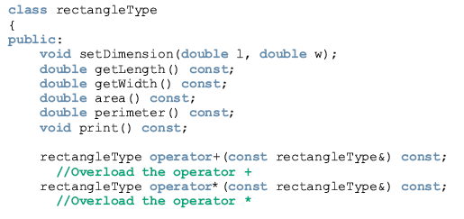
Example
Let us overload +, *, ==, and != for the class rectangleType. These operators are overloaded as member functions.
C++ Programming: From Problem Analysis to Program Design, Sixth Edition

Slide 24
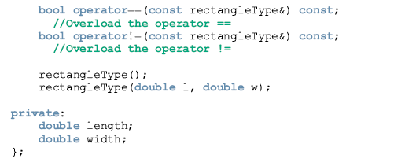
C++ Programming: From Problem Analysis to Program Design, Sixth Edition

Slide 25
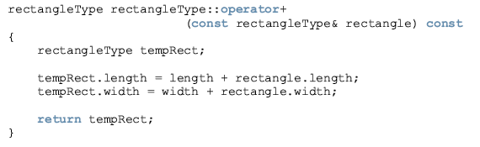
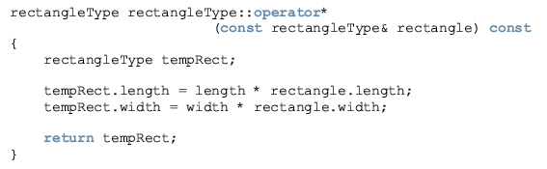
C++ Programming: From Problem Analysis to Program Design, Sixth Edition

Slide 26
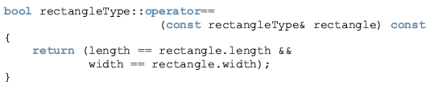
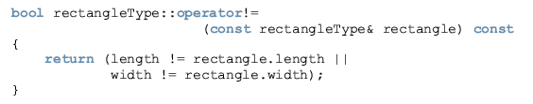
C++ Programming: From Problem Analysis to Program Design, Sixth Edition

Slide 27
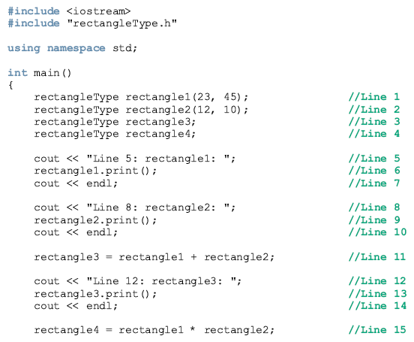
C++ Programming: From Problem Analysis to Program Design, Sixth Edition

Slide 28
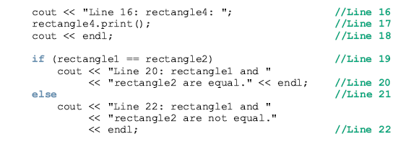
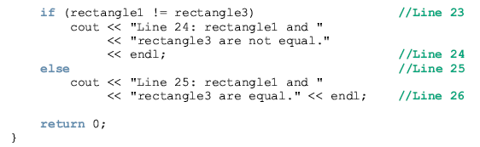
C++ Programming: From Problem Analysis to Program Design, Sixth Edition

Slide 29
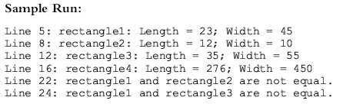
C++ Programming: From Problem Analysis to Program Design, Sixth Edition

Slide 30

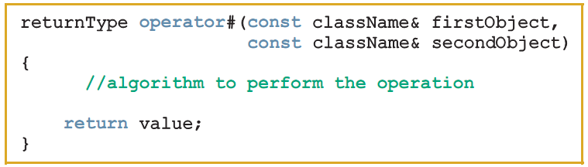
Overloading the Arithmetic or Relational Operators
Function prototype (included in class definition):
Function definition:
C++ Programming: From Problem Analysis to Program Design, Sixth Edition

Slide 31
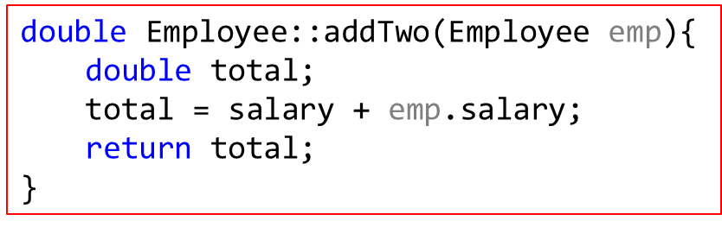
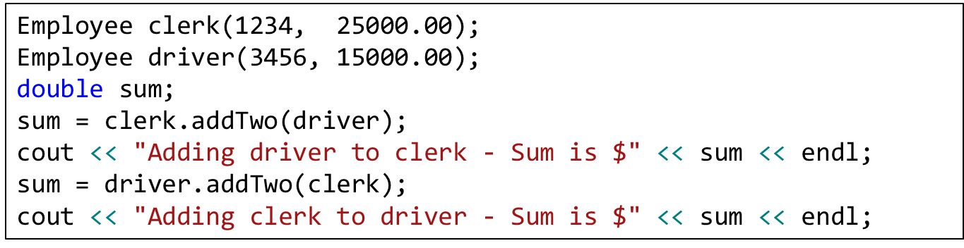
Without Overloading the Arithmetic
Assume that you have an Employee class with two data members—idNum and salary— and a constructor as well as a member function that adds two Employees’ salaries.
C++ Programming: From Problem Analysis to Program Design, Sixth Edition

Slide 32
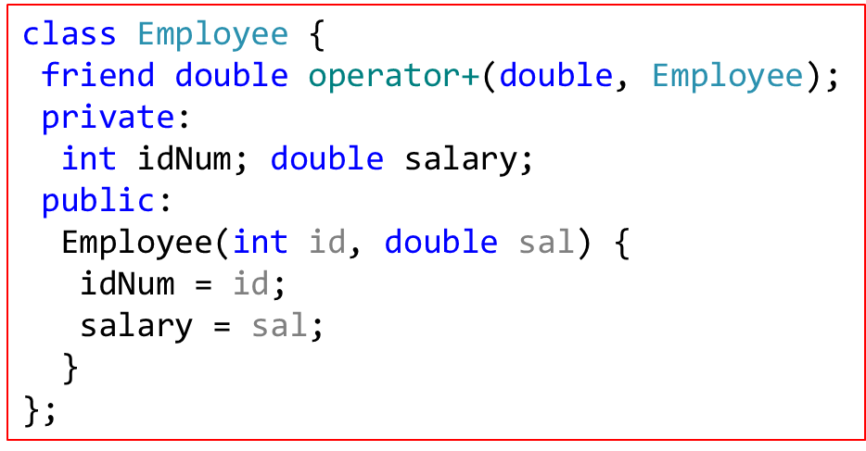
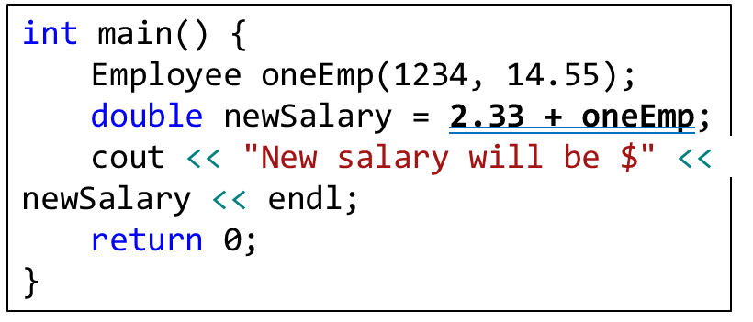
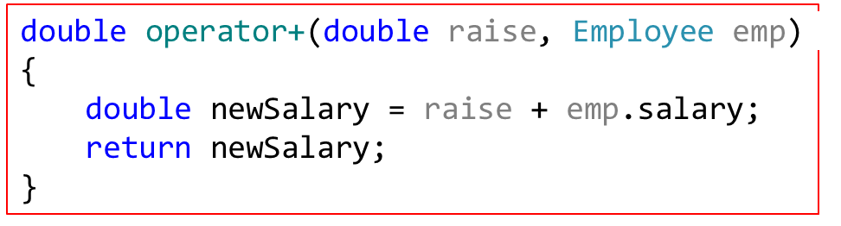
OVERLOADING AN OPERATOR TO WORK WITH AN OBJECT AND A PRIMITIVE TYPE
C++ Programming: From Problem Analysis to Program Design, Sixth Edition
Notes:
class Employee {
friend double operator+(double, Employee);
private:
int idNum; double salary;
public:
Employee(int, double);
};
Employee::Employee(int id, double sal) {
idNum = id;
salary = sal;
}
double operator+(double raise, Employee emp) {
double newSalary = raise + emp.salary;
return newSalary;
}
int main() {
Employee oneEmp(1234, 14.55);
double newSalary = 2.33 + oneEmp;
cout << "New salary will be $" << newSalary << endl;
return 0;
}

Slide 33
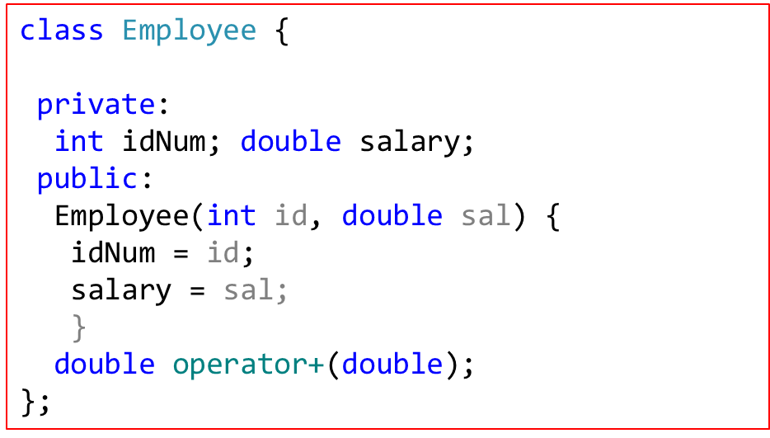
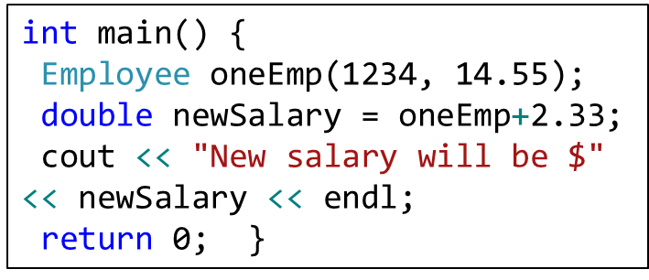
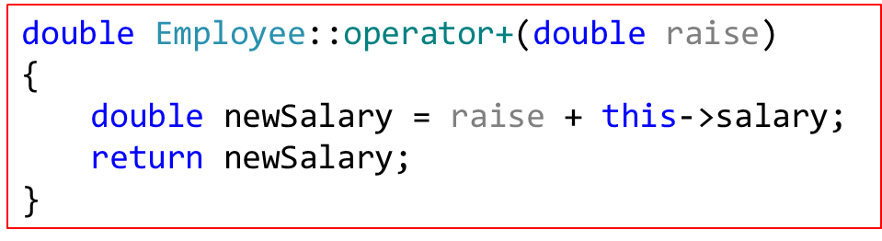
OVERLOADING AN OPERATOR TO WORK WITH AN OBJECT AND A PRIMITIVE TYPE
C++ Programming: From Problem Analysis to Program Design, Sixth Edition
Notes:
class Employee {
private: int idNum; double salary;
public:
Employee(int, double);
double operator+(double);
};
Employee::Employee(int id, double sal) {
idNum = id; salary = sal; }
double Employee::operator+(double raise)
{ double newSalary = raise+ this->salary;
return newSalary;
}
int main() {
Employee oneEmp(1234, 14.55);
double newSalary = oneEmp+2.33;
cout << "New salary will be $" << newSalary << endl;
return 0;
}

Slide 34
Overloading the Stream Insertion (<<) and Extraction (>>) Operators
Consider the expression:
  cout << myRectangle;
  Leftmost operand is an ostream object, not a rectangleType object
Thus, the operator function that overloads << for rectangleType must be a nonmember function of the class
  Same applies to the function that overloads >>
C++ Programming: From Problem Analysis to Program Design, Sixth Edition

Slide 35
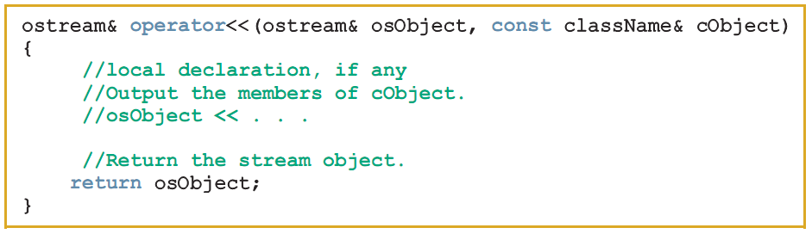
Overloading the
Stream Insertion Operator (<<)
Function prototype:
Function definition:
C++ Programming: From Problem Analysis to Program Design, Sixth Edition

Slide 36
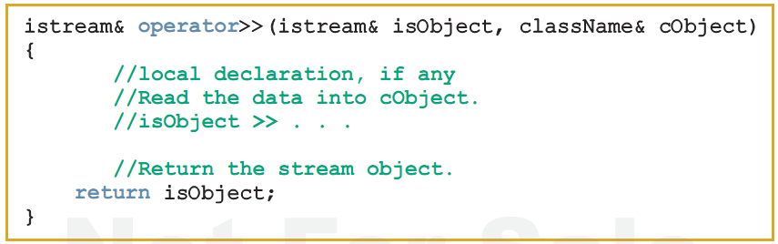
Overloading the Stream Extraction Operator (>>)
Function prototype:
Function definition:
C++ Programming: From Problem Analysis to Program Design, Sixth Edition

Slide 37
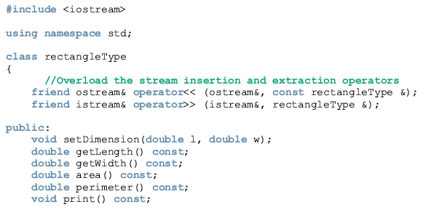
Example
This example shows how the stream insertion and extraction operators are overloaded for the class rectangleType.
C++ Programming: From Problem Analysis to Program Design, Sixth Edition

Slide 38
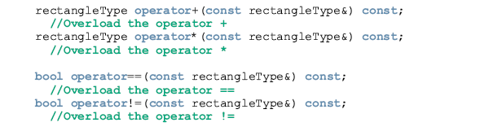
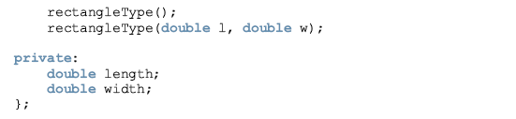
Example
This example shows how the stream insertion and extraction operators are overloaded for the class rectangleType.
C++ Programming: From Problem Analysis to Program Design, Sixth Edition

Slide 39
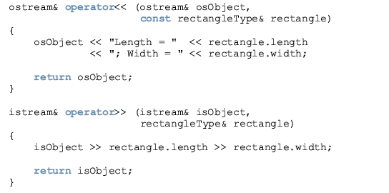
Example
This example shows how the stream insertion and extraction operators are overloaded for the class rectangleType.
C++ Programming: From Problem Analysis to Program Design, Sixth Edition

Slide 40
Example
This example shows how the stream insertion and extraction operators are overloaded for the class rectangleType.
#include <iostream>
#include "rectangleType.h"
using namespace std;
int main() {
rectangleType myRectangle(23, 45); //Line 1
rectangleType yourRectangle; //Line 2
cout << "Line 3:
myRectangle: " << myRectangle << endl; //Line 3
cout << "Line 4: Enter the length and width " <<"of a rectangle: "; //Line 4
cin >> yourRectangle; //Line 5
cout << endl; //Line 6
cout << "Line 7: yourRectangle: " << yourRectangle << endl; //Line 7
cout << "Line 8: myRectangle + yourRectangle: " << myRectangle + yourRectangle << endl; //Line 8
cout << "Line 9: myRectangle * yourRectangle: " << myRectangle * yourRectangle << endl; //Line 9
return 0;
}
C++ Programming: From Problem Analysis to Program Design, Sixth Edition

Slide 41
Example
This example shows how the stream insertion and extraction operators are overloaded for the class rectangleType.
Sample Run: In this sample run, the user input is shaded.
Line 3: myRectangle: Length = 23; Width = 45
Line 4: Enter the length and width of a rectangle: 32 15
Line 7: yourRectangle: Length = 32; Width = 15
Line 8: myRectangle + yourRectangle: Length = 55; Width = 60
Line 9: myRectangle * yourRectangle: Length = 736; Width = 675
C++ Programming: From Problem Analysis to Program Design, Sixth Edition

Slide 42
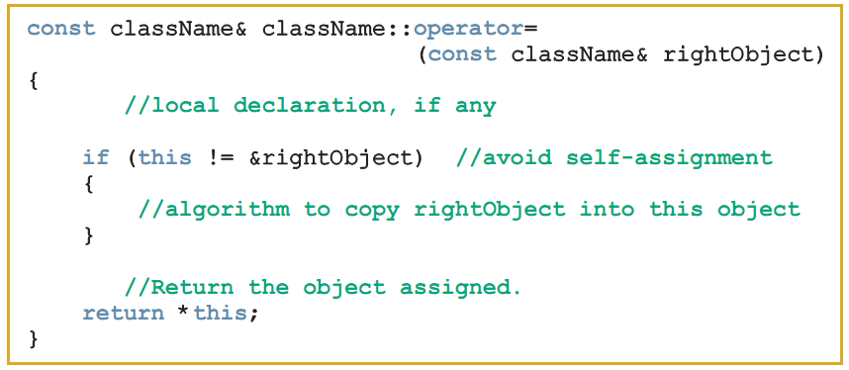
Overloading the Assignment Operator (=)
Function prototype:
Function definition:
C++ Programming: From Problem Analysis to Program Design, Sixth Edition

Slide 43
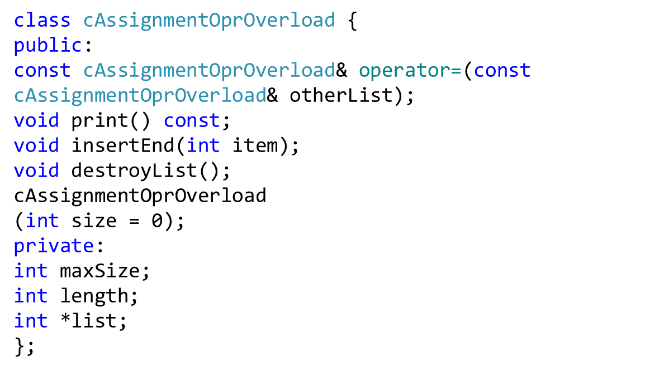
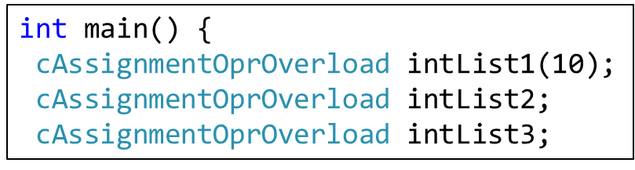
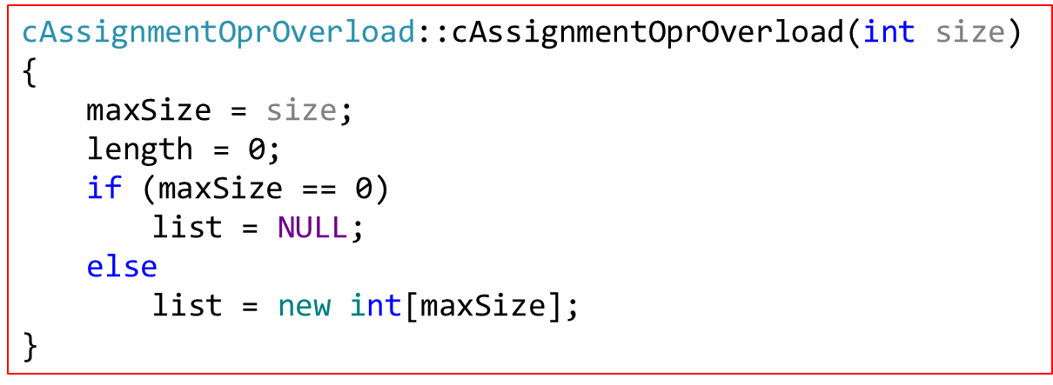
Overloading the Assignment Operator (=)
C++ Programming: From Problem Analysis to Program Design, Sixth Edition

Slide 44
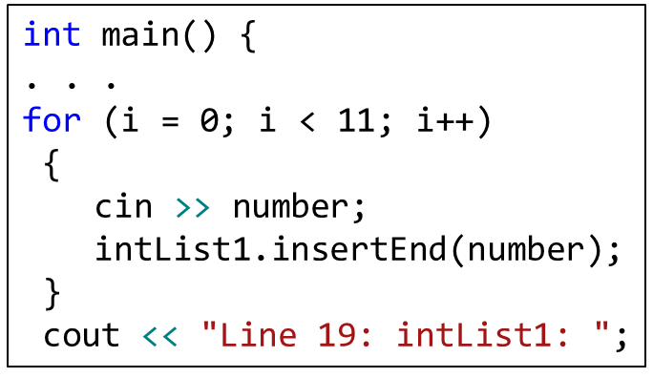
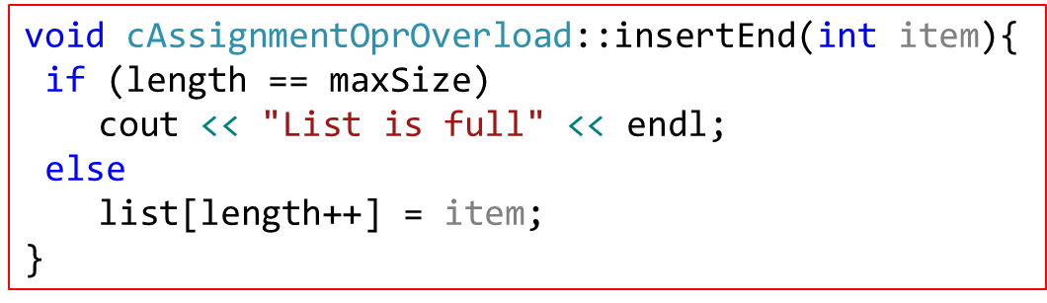
Overloading the Assignment Operator (=)
C++ Programming: From Problem Analysis to Program Design, Sixth Edition

Slide 45
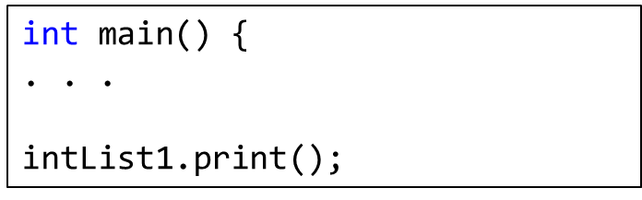
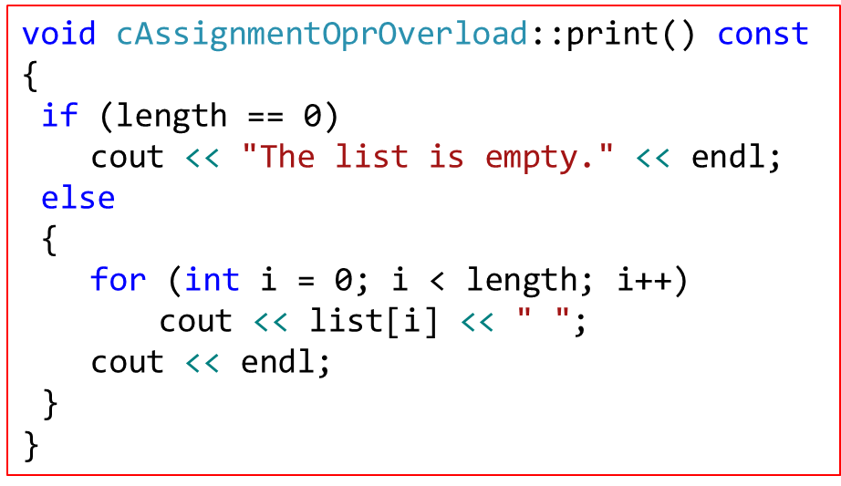
Overloading the Assignment Operator (=)
C++ Programming: From Problem Analysis to Program Design, Sixth Edition

Slide 46
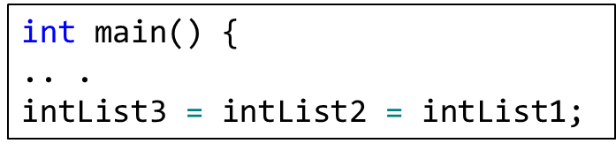

Overloading the Assignment Operator (=)
C++ Programming: From Problem Analysis to Program Design, Sixth Edition

Slide 47

Overloading the Assignment Operator (=)
C++ Programming: From Problem Analysis to Program Design, Sixth Edition

Slide 48

Overloading the Assignment Operator (=)
C++ Programming: From Problem Analysis to Program Design, Sixth Edition

Slide 49
Overloading Unary Operators
To overload a unary operator for a class:
  If the operator function is a member of the class, it has no parameters
  If the operator function is a nonmember (i.e., a friend function), it has one parameter
C++ Programming: From Problem Analysis to Program Design, Sixth Edition

Slide 50


Overloading the Increment (++) and Decrement (--) Operators
General syntax to overload the pre-increment operator ++ as a member function
  Function prototype:
  Function definition:
rectangleType rectangleType::operator++( ) { //increment the length and width ++length; ++width;
return *this;
}
++myRectangle;
yourRectangle = ++myRectangle;
C++ Programming: From Problem Analysis to Program Design, Sixth Edition

Slide 51


Overloading the Increment (++) and Decrement (--) Operators (cont’d.)
General syntax to overload the pre-increment operator ++ as a nonmember function:
  Function prototype:
  Function definition:
rectangleType operator++(rectangleType& rectangle) {
//increment the length and width of the rectangle (rectangle.length)++;
(rectangle.width)++;
return rectangle; //return the incremented //value of the object
}
C++ Programming: From Problem Analysis to Program Design, Sixth Edition

Slide 52


Overloading the Increment (++) and Decrement (--) Operators (cont’d.)
General syntax to overload the post-increment operator ++ as a member function:
  Function prototype:
  Function definition:
The post-increment operator first uses the value of the object in the expression and then increments the value of the object. So the steps required to implement this function are:
Save the value of the object—in, say, temp.
2. Increment the value of the object. 3.
Return the value that was saved in temp.
C++ Programming: From Problem Analysis to Program Design, Sixth Edition
Notes:
rectangleType operator++(int);
The statement:
myRectangle++;
is compiled by the compiler in the statement:
myRectangle.operator++(0);

Slide 53

Overloading the Increment (++) and Decrement (--) Operators (cont’d.)
Syntax to overload the post-increment operator ++ as a nonmember function:
  Function prototype:
  Function definition:
C++ Programming: From Problem Analysis to Program Design, Sixth Edition

Slide 54
Operator Overloading:
Member Versus Nonmember
Some operators must be overloaded as member functions and some must be overloaded as nonmember (friend) functions
What about the operators that can be overloaded as either member functions or nonmember functions?
C++ Programming: From Problem Analysis to Program Design, Sixth Edition

Slide 55
Operator Overloading:
Member Versus Nonmember (cont’d.)
Binary arithmetic operator + can be overloaded either way
Overload + as a member function
  As a member function, operator + has direct access to data members of one of the objects
  Need to pass only one object as a parameter
Overload + as a nonmember function
  Must pass both objects as parameters
  Code may be somewhat clearer this way
C++ Programming: From Problem Analysis to Program Design, Sixth Edition

Slide 56
Classes and Pointer Member Variables (Revisited)
Recall that assignment operator copies member variables from one object to another of the same type (member-wise copy)
  Does not work well with pointer member variables
Classes with pointer member variables must:
  Explicitly overload the assignment operator
  Include the copy constructor
  Include the destructor
C++ Programming: From Problem Analysis to Program Design, Sixth Edition

Slide 57
Operator Overloading:
One Final Word
If an operator op is overloaded for a class, e.g., rectangleType
  When you use op on objects of type rectangleType, the body of the function that overloads the operator op for the class rectangleType executes
  Therefore, whatever code you put in the body of the function executes
C++ Programming: From Problem Analysis to Program Design, Sixth Edition

Slide 58


Overloading the Array Index (Subscript) Operator ([])
Syntax to declare operator[] as a member of a class for nonconstant arrays:
Syntax to declare operator[] as a member of a class for constant arrays:
classTest list1;
classTest list2;
const classTest list3;
list1[2] = list2[3];
list1[2] = list3[5];
C++ Programming: From Problem Analysis to Program Design, Sixth Edition
Notes:
Recall that the function to overload the operator [] for a class must be a member of the class. Furthermore, because an array can be declared as constant or nonconstant, we need to overload the operator [] to handle both cases.

Slide 59
Function Overloading
Overloading a function: several functions with the same name, but different parameters
  Parameter list determines which function will execute
  Must provide the definition of each function
C++ Programming: From Problem Analysis to Program Design, Sixth Edition

Slide 60

Templates
Template: a single code body for a set of related functions (function template) and related classes (class template)
Syntax:
  Type is the data type
  Declaration is either a function declaration or a class declaration
C++ Programming: From Problem Analysis to Program Design, Sixth Edition

Slide 61
Templates (cont’d.)
class in the heading refers to any user-defined type or built-in type
Type: a formal parameter to the template
Just as variables are parameters to functions, data types are parameters to templates
C++ Programming: From Problem Analysis to Program Design, Sixth Edition

Slide 62

Function Templates
Syntax of the function template:
Type is a formal parameter of the template used to:
  Specify type of parameters to the function
  Specify return type of the function
  Declare variables within the function
C++ Programming: From Problem Analysis to Program Design, Sixth Edition
Notes:
cout << larger(2, 3) << endl;
cout << larger(2.9, 3.3) << endl;
cout << larger ('a', 'A')<<endl;

Slide 63

Function Templates
C++ Programming: From Problem Analysis to Program Design, Sixth Edition

Slide 64

Class Templates
Class template: a single code segment for a set of related classes
  Called parameterized types: based on the parameter type, a specific class is generated.
Syntax:
A template instantiation can be created with either a built-in or user-defined type
The function members of a class template are considered to be function templates
C++ Programming: From Problem Analysis to Program Design, Sixth Edition

Slide 65
Header File and Implementation File of a Class Template
Passing a parameter to a function takes effect at run time
Passing a parameter to a class template takes effect at compile time
Cannot compile the implementation file independently of the client code
  Can put class definition and definitions of the function templates directly in the client code
  Can put class definition and the definitions of the function templates in the same header file
C++ Programming: From Problem Analysis to Program Design, Sixth Edition

Slide 66
Header File and Implementation File of a Class Template (cont’d.)
Another alternative: put class definition and function definitions in separate files
  Include directive to implementation file at the end of header file
In either case, function definitions and client code are compiled together
C++ Programming: From Problem Analysis to Program Design, Sixth Edition

Slide 67

Error-Prevention Tip
C++ Programming: From Problem Analysis to Program Design, Sixth Edition
Notes:
The class definition is enclosed in the following preprocessor wrapper
#ifndef H_listType
#define H_listType
When we build larger programs,other definitions and declarations will also be placed in headers. The preceding preprocessor wrapper prevents the code between #ifndef (which means“if notdefined”) and #endif from beingincludedifthe name TIME_H hasbeendefined. If theheaderhas not been included previouslyinafile,the name TIME_H is defined by the #define directiveand theheaderstatements are included.Ifthe header hasbeen included previously, TIME_H is defined alreadyand theheaderisnot included again. Attemptstoincludeaheadermultipletimes(inadvertently)typicallyoccurinlargeprograms with many headersthatmay themselves includeother headers.
Time Class Member Functions InFig. 9.2,the Time constructor(lines11–14)initializesthedatamembersto0—theuniversal-timeequivalentof12AM. Invalid values cannot be stored in thedata membersof aTimeobject,becausetheconstructoriscalledwhentheTimeobjectiscreated,andallsubsequentattemptsbyaclienttomodifythe data membersare scrutinizedbyfunction setTime (discussed shortly). Finally, it’s importantton otethat youc an define several overloadedconstructors foraclass.
Good ProgrammingPractice9.1 For clarity and readability, useeachaccessspecifier onlyonceinaclass definition. Place public membersfirst, wherethey’re easytolocate.
Software EngineeringObservation9.1 Each elementofaclass should have private visibility unless it canbeproven that the elementneeds public visibility.Thisisanotherexampleoftheprinciple ofleastprivilege.
// prevent multiple inclusions of header #ifndef TIME_H #define TIME_H ... #endif
Error-PreventionTip 9.1 Use #ifndef, #define and #endif preprocessordirectivestoformapreprocessorwrapper that prevents headersfrombeing included more thanonceinaprogram.

Slide 68



Class Template
C++ Programming: From Problem Analysis to Program Design, Sixth Edition
Notes:
The class definition is enclosed in the following preprocessor wrapper
#ifndef H_listType
#define H_listType
When we build larger programs,other definitions and declarations will also be placed in headers. The preceding preprocessor wrapper prevents the code between #ifndef (which means“if notdefined”) and #endif from beingincludedifthe name TIME_H hasbeendefined. If theheaderhas not been included previouslyinafile,the name TIME_H is defined by the #define directiveand theheaderstatements are included.Ifthe header hasbeen included previously, TIME_H is defined alreadyand theheaderisnot included again. Attemptstoincludeaheadermultipletimes(inadvertently)typicallyoccurinlargeprograms with many headersthatmay themselves includeother headers.
Time Class Member Functions InFig. 9.2,the Time constructor(lines11–14)initializesthedatamembersto0—theuniversal-timeequivalentof12AM. Invalid values cannot be stored in thedata membersof aTimeobject,becausetheconstructoriscalledwhentheTimeobjectiscreated,andallsubsequentattemptsbyaclienttomodifythe data membersare scrutinizedbyfunction setTime (discussed shortly). Finally, it’s importantton otethat youc an define several overloadedconstructors foraclass.
Good ProgrammingPractice9.1 For clarity and readability, useeachaccessspecifier onlyonceinaclass definition. Place public membersfirst, wherethey’re easytolocate.
Software EngineeringObservation9.1 Each elementofaclass should have private visibility unless it canbeproven that the elementneeds public visibility.Thisisanotherexampleoftheprinciple ofleastprivilege.
// prevent multiple inclusions of header #ifndef TIME_H #define TIME_H ... #endif
Error-PreventionTip 9.1 Use #ifndef, #define and #endif preprocessordirectivestoformapreprocessorwrapper that prevents headersfrombeing included more thanonceinaprogram.

Slide 69
Summary
An operator that has different meanings with different data types is said to be overloaded
Operator function: a function that overloads an operator
  operator is a reserved word
  Operator functions are value-returning
Operator overloading provides the same concise notation for user-defined data types as for built-in data types
C++ Programming: From Problem Analysis to Program Design, Sixth Edition

Slide 70
Summary (cont’d.)
Only existing operators can be overloaded
The pointer this refers to the object
A friend function is a nonmember of a class
If an operator function is a member of a class
  The leftmost operand of the operator must be a class object (or a reference to a class object) of that operator’s class
C++ Programming: From Problem Analysis to Program Design, Sixth Edition

Slide 71
Summary (cont’d.)
Classes with pointer variables must overload the assignment operator, and include both a copy constructor and deconstructor
Templates:
  Function template: a single code segment for a set of related functions
  Class template: a single code segment for a set of related classes
    Are called parameterized types
C++ Programming: From Problem Analysis to Program Design, Sixth Edition

